Slide 1
Intro to Cloud Computing CS4037 (BCS-6A) Lecture 18
Dept. of Computer Science
FAST School of Computing
NUCES Lahore

Slide 2
Module 9: Cloud Architecture
AWS Academy Cloud Foundations

Slide 3
Module overview
Topics
AWS Well-Architected Framework
AWS Trusted Advisor
Activities
AWS Well-Architected Framework Design Principles
Interpret AWS Trusted Advisor Recommendations

Slide 4
Module objectives
After completing this module, you should be able to:
Describe the AWS Well-Architected Framework, including the six pillars
Identify the design principles of the AWS Well-Architected Framework
Identify how AWS Trusted Advisor helps customers
Interpret AWS Trusted Advisor recommendations

Slide 5
Section 1: AWS Well-Architected Framework
Module 9: Cloud Architecture

Slide 6




Architecture: designing and building
Architect
Structure design
Customer (Decision maker)
Completed structure
Building crew (Delivery team)

Slide 7
Architecture: designing and building
Art and science of designing and building large structures
Large systems require architects to manage their size and complexity
Cloud architects:
Engage with decision makers to identify the business goal and the capabilities that need improvement.
Ensure alignment between technology deliverables of a solution and the business goals.
Work with delivery teams that are implementing the solution to ensure that the technology features are appropriate.
Having well-architected systems greatly increases the likelihood of business success.

Slide 8
What is the AWS Well-Architected Framework?
A guide for designing infrastructures that are:
Secure
High-performing
Resilient
Efficient
A consistent approach to evaluating and implementing cloud architectures
A way to provide best practices that were developed through lessons learned by reviewing customer architectures

Slide 9
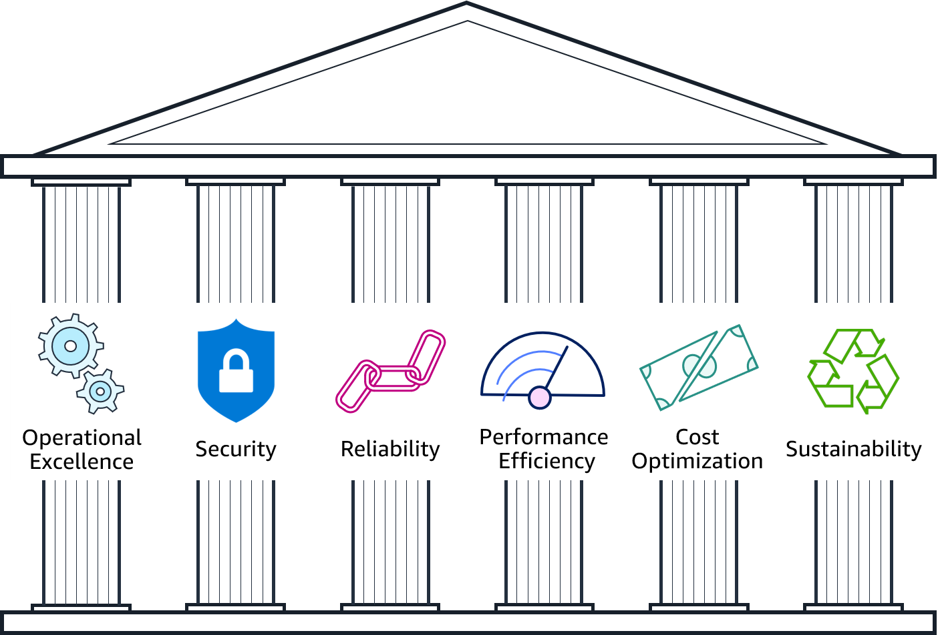
Pillars of the AWS Well-Architected Framework

Slide 10

Operational excellence design principles
Operational Excellence
pillar
Perform operations as code
With defined SOPs
Make frequent, small, reversible changes
Refine operations procedures frequently
Anticipate failure
Learn from all operational events and failures
Deliver business value

Slide 11

Security design principles
Security
pillar
Implement a strong identity foundation
IAM, AD Policies
Enable traceability
Apply security at all layers
Automate security best practices
Protect data in transit and at rest
Keep people away from data
Prepare for security events
Protect and monitor systems

Slide 12

Reliability design principles
Reliability
pillar
Automatically recover from failure
Test recovery procedures
Scale horizontally to increase aggregate workload availability
Using multiple small systems rather single large system
Manage change in automation
Recover from failure and mitigate disruption.

Slide 13

Performance efficiency design principles
Performance Efficiency
pillar
Democratize advanced technologies
Specialized depts. for ML, DBMS
Use serverless architectures
Consider mechanical sympathy
Use the technology approach that aligns best to what you are trying to achieve
Example: consider data access patterns when selecting approaches for databases or storage
Use resources sparingly.

Slide 14

Cost optimization design principles
Cost Optimization pillar
Implement Cloud Financial Management
Adopt a consumption model
Stop spending money on undifferentiated heavy lifting
Analyze and attribute expenditure
Eliminate unneeded expense.

Slide 15

Section 1 key takeaways
The AWS Well-Architected Framework provides a consistent approach to evaluate cloud architectures and guidance to help implement designs.
The AWS Well-Architected Framework documents a set of design principles and best practices that enable you to understand if a specific architecture aligns well with cloud best practices.
The AWS Well-Architected Framework is organized into six pillars.
Each pillar includes its own set of design principles and best practices.

Slide 16
Section 3: AWS Trusted Advisor
Module 9: Cloud Architecture

Slide 17

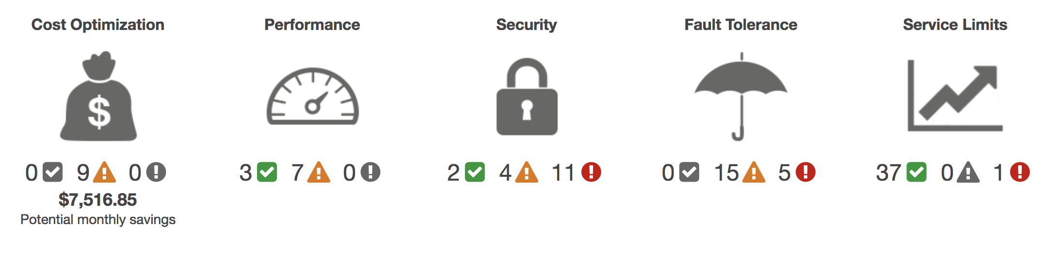
AWS Trusted Advisor
Online tool that provides real-time guidance to help you provision your resources following AWS best practices.
Looks at your entire AWS environment and gives you real-time recommendations in five categories.
AWS Trusted Advisor
Cost Optimization
Performance
Security
Fault Tolerance
Service Limits
Potential monthly savings

Slide 18
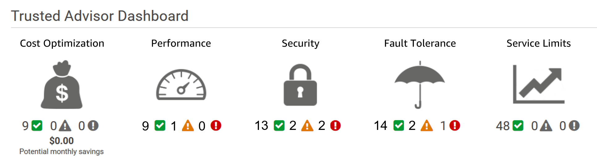
Activity: Interpret AWS Trusted Advisor recommendations

Slide 19

Activity: Recommendation #1
MFA on Root Account
Description: Checks the root account and warns if multi-factor authentication (MFA) is not enabled. For increased security, we recommend that you protect your account by using MFA, which requires a user to enter a unique authentication code from their MFA hardware or virtual device when interacting with the AWS console and associated websites.
Alert Criteria: MFA is not enabled on the root account.
Recommended Action: Log in to your root account and activate an MFA device.

Slide 20
Activity: Recommendation #2
IAM Password Policy
Description: Checks the password policy for your account and warns when a password policy is not enabled, or if password content requirements have not been enabled. Password content requirements increase the overall security of your AWS environment by enforcing the creation of strong user passwords. When you create or change a password policy, the change is enforced immediately for new users but does not require existing users to change their passwords.
Alert Criteria: A password policy is enabled, but at least one content requirement is not enabled.
Recommended Action: If some content requirements are not enabled, consider enabling them. If no password policy is enabled, create and configure one. See Setting an Account Password Policy for IAM Users.

Slide 21
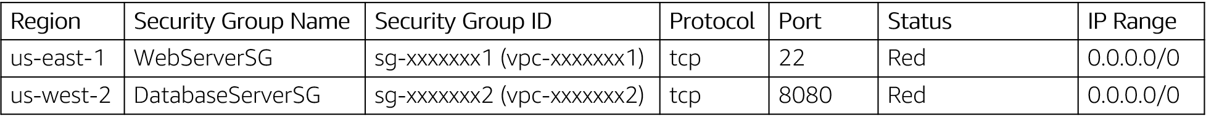
Activity: Recommendation #3
Security Groups – Unrestricted Access
Description: Checks security groups for rules that allow unrestricted access to a resource. Unrestricted access increases opportunities for malicious activity (hacking, denial-of-service attacks, loss of data).
Alert Criteria: A security group rule has a source IP address with a /0 suffix for ports other than 25, 80, or 443.)
Recommended Action: Restrict access to only those IP addresses that require it. To restrict access to a specific IP address, set the suffix to /32 (for example, 192.0.2.10/32). Be sure to delete overly permissive rules after creating rules that are more restrictive.

Slide 22
Activity: Recommendation #4
Amazon EBS Snapshots
Description: Checks the age of the snapshots for your Amazon Elastic Block Store (Amazon EBS) volumes (available or in-use). Even though Amazon EBS volumes are replicated, failures can occur. Snapshots are persisted to Amazon Simple Storage Service (Amazon S3) for durable storage and point-in-time recovery.
Alert Criteria:
Yellow: The most recent volume snapshot is between 7 and 30 days old.
Red: The most recent volume snapshot is more than 30 days old.
Red: The volume does not have a snapshot.
Recommended Action: Create weekly or monthly snapshots of your volumes

Slide 23
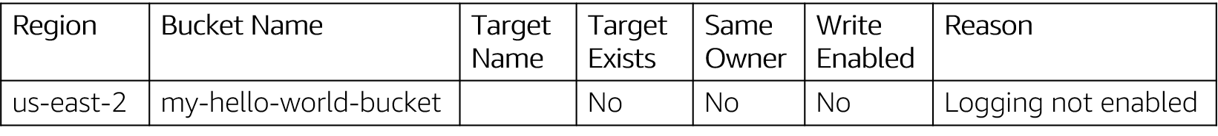
Activity: Recommendation #5
Amazon S3 Bucket Logging
Description: Checks the logging configuration of Amazon Simple Storage Service (Amazon S3) buckets. When server access logging is enabled, detailed access logs are delivered hourly to a bucket that you choose. An access log record contains details about each request, such as the request type, the resources specified in the request, and the time and date the request was processed. By default, bucket logging is not enabled; you should enable logging if you want to perform security audits or learn more about users and usage patterns.
Alert Criteria:
Yellow: The bucket does not have server access logging enabled. Yellow: The target bucket permissions do not include the owner account. Trusted Advisor cannot check it. Recommended Action: Enable bucket logging for most buckets.
If the target bucket permissions do not include the owner account and you want Trusted Advisor to check the logging status, add the owner account as a grantee.

Slide 24
Section 3 key takeaways
AWS Trusted Advisor is an online tool that provides real-time guidance to help you provision your resources by following AWS best practices.
AWS Trusted Advisor looks at your entire AWS environment and gives you real-time recommendations in five categories.
You can use AWS Trusted Advisor to help you optimize your AWS environment as soon as you start implementing your architecture designs.

Slide 25
Module wrap-up
Module 9: Cloud Architecture

Slide 26
Module summary
In summary, in this module you learned how to:
Describe the AWS Well-Architected Framework, including the six pillars
Identify the design principles of the AWS Well-Architected Framework
Identify how AWS Trusted Advisor helps customers
Interpret AWS Trusted Advisor recommendations

Slide 27
Additional resources
AWS Well-Architected website: https://aws.amazon.com/architecture/well-architected/?wa-lens-whitepapers.sort-by=item.additionalFields.sortDate&wa-lens-whitepapers.sort-order=desc
AWS Well-Architected Labs: https://wellarchitectedlabs.com/
AWS Trusted Advisor Best Practice Checks: https://docs.aws.amazon.com/awssupport/latest/user/trusted-advisor-check-reference.html

Slide 28
Thank you
All trademarks are the property of their owners.

